Slide 1
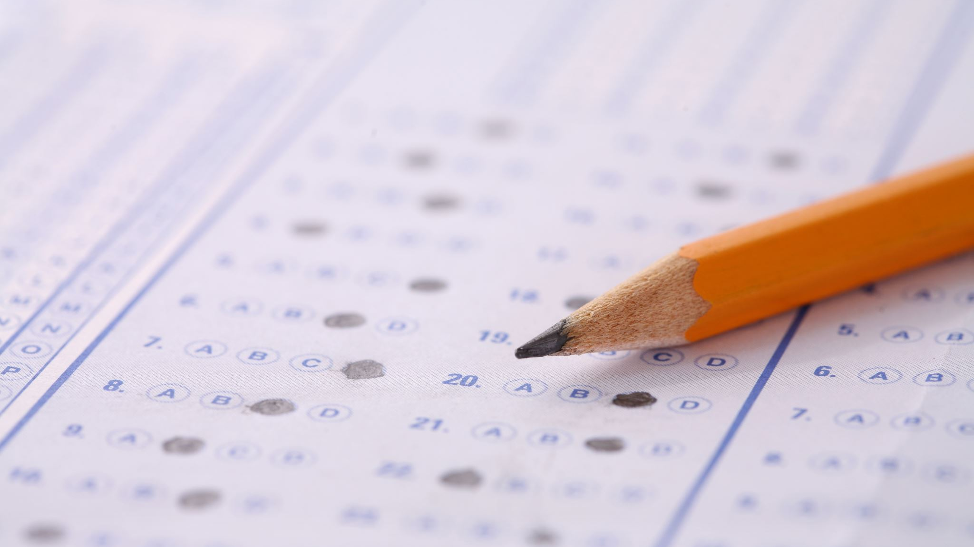
Exam Generator

Slide 2
Slides Prepared by:
Aisha Soliman
Mohammed Ashraf
Mostafa Ashraf
Mostafa Ayman
Mostafa Labib
Mostafa Hesham
Under Supervision of:
Dr. Sally S. Ismail
AL. Asmaa Bahai Eldin Kassem

Slide 3
Introduction
The application takes text as input and generates questions on it with their answers.
Question generation (QG) and question answering (QA) are both branches of Natural Language Processing.
QG is the process of creating new questions. While QA is about finding an answer to a question.
Two main approaches to QG: rule-based and neural network based.
Rule-based VS neural network based.

Slide 4
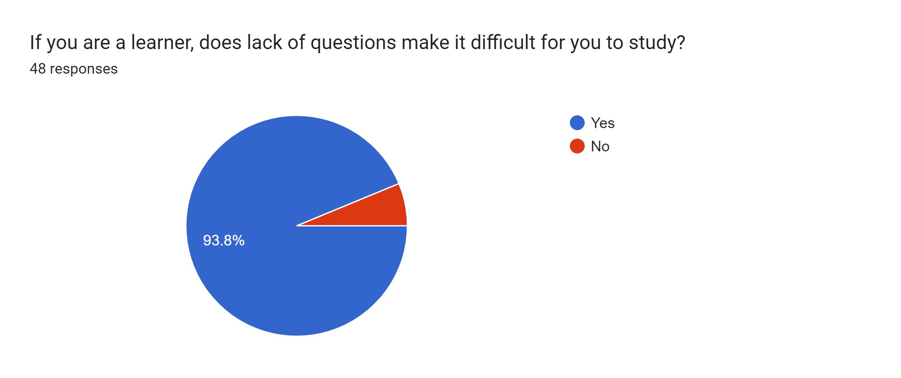
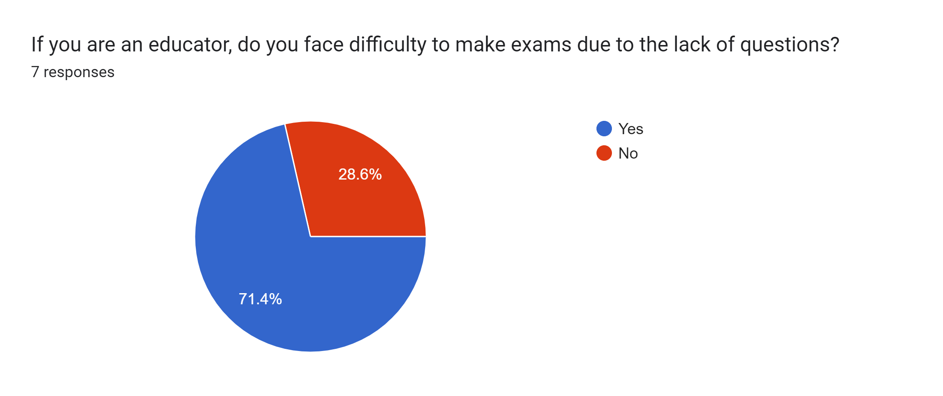
Motivation
Problems:
Lack of exercises on teaching material.
Negative effects on educators and students.
Difficulty of self-learning despite availability of resources.
Proposed Solution:
Automatic exam generation.

Slide 5
Objective
Develop a web application that helps students practice and educators write exams with the following features:
Summarize text into question-and-answer pairs.
Generate different types of questions.
Create a user-friendly interface in the form of a web application.

Slide 6
System Architecture

Slide 7
Educator/Student
User Interface
Text
Questions and Answers
Answer Extraction
WH QG Model
Interrogative Word Classifier
Boolean QG Model
Application Layer
MCQ & Complete Model
Datasets
User Data
Data Access Layer

Slide 8
Phases Description
Answer Extraction
Extract question-worthy key-phrases from text.
Sequence-to-sequence model using transformer architecture.
Interrogative Word Classifier
Choose a question word based on embeddings of context and answer.
Transformer-based classifier model.

Slide 9
Phases Description
WH QG
Generate WH-style questions given the following: context, interrogative word, and answer.
Sequence-to-sequence model using Transformer architecture.
Boolean QG
Generate true/false questions based on the context and a boolean answer.
Sequence-to-sequence model using Transformer architecture.
MCQ & Complete
Extract all named entities from the context then try to find distractors to them.
Sense2Vec model is utilized to find the distractors .

Slide 10
Datasets
Dataset | Description | Used For Training
SQuAD 1.1 | A reading comprehension dataset, consisting of about 100,000 questions posed by crowdworkers on a set of Wikipedia articles, where the answer to every question is a segment of text, or span, from the corresponding reading passage. | Answer Extraction, Interrogative Word Classifier, WH QG
NewsQA | A reading comprehension dataset of over 100,000 human-generated question-answer pairs. Crowdworkers supply questions and answers based on a set of over 10,000 news articles from CNN, with answers consisting of spans of text from the corresponding articles. | Answer Extraction, Interrogative Word Classifier, WH QG

Slide 11
Datasets
Dataset | Description | Used For Training
Adversarial QA | A Reading Comprehension datasets, constructed using an adversarial model-in-the-loop. with 10,000 training examples, 1,000 validation, and 1,000 test examples. | Interrogative Word Classifier, WH QG
BoolQ | BoolQ is a question answering dataset for yes/no questions containing about 16,000 examples. These questions are naturally occurring i.e. they are generated in unprompted and unconstrained settings. | Boolean QG

Slide 12
Challenges

Slide 13
Answer Extraction Model
Goal
To extract question-worthy key-phrases given passage.
Challenges
Lack of papers on this specific task .
NER (Named-Entity Recognition) over generates key-phrases.
Solutions
Utilize powerful model (T5) to extract question-worthy key-phrases from the given passage.

Slide 14
Interrogative Word Classifier Model
Goal
Classify the interrogative word of the question.
Challenges
Choosing the best 5 NER tags and to pass it to the model.
The accuracy was lower than expected.
An answer may have more than one named entity.
Solutions
Using statistical analysis of the datasets determine which the most frequent NER to use.
Add additional two datasets to increase the accuracy.
Extract the chosen named entities which belong to one of the 5 NER tags from the answer.

Slide 15
WH Question Generation Model
Goal
To generate WH-style questions on the text.
Challenges
Sometimes the model generates questions with wrong the interrogative word.
Solutions
Implement the Interrogative Word Classifier.

Slide 16
Boolean Question Generation Model
Goal
Generate true/false questions on text.
Challenges
Lack of papers on this specific task .
Small dataset size.
Solutions
Tried data augmentation by paraphrasing questions in the dataset.
Train for few epochs with relatively small model sizes to avoid overfitting.

Slide 17
MCQ & Complete Model
Goal
Generate MCQ and complete questions from text.
Challenges
Spelling mistakes.
Generate nondomain-specific distractors.
Solutions
Apply multiple filtering techniques to avoid duplicate distractors.
Use Reddit comments.

Slide 18
Experiments & Results

Slide 19
Answer Extraction
Baseline Models
SpaCy NER: Using spaCy library to detect all named-entities in a document.
YAKE: A light-weight unsupervised automatic keyword extraction method which rests on text statistical features extracted from single documents to select the most important keywords of a text.
PtrNet: A pointer network which uses RNN encoder and decoder that points to key phrase start and end boundaries.
Chosen Model
T5: An encoder-decoder transformer model pre-trained on a multi-task mixture of unsupervised and supervised tasks and for which each task is converted into a text-to-text format.

Slide 20
Answer Extraction
Model | F1 | Precision | Recall
SQuAD
spaCy NER | 26.4 % | 30.7% | 23.2%
YAKE | 23.8 % | 28.6 % | 20.3 %
PtrNet | 40.4% | 44.8 % | 38.7%
T5-small (Chosen) | 48.0% | 45.0% | 51.5%
NewsQA
spaCy NER | 10.1% | 12.5% | 8.5%
YAKE | 24.0% | 28.7% | 20.7%
PtrNet | 43.5% | 46.7% | 42.7%
T5-small (Chosen) | 40.3% | 37.3% | 43.9%

Slide 21
Interrogative Word Classifier
Model | Dataset | Batch-size | Training-Accuracy | Validation-Accuracy
Bert-base Model | SQuAD V.1 | 8 | 75.96% | 71.74%
Bert-base Model(Chosen) | SQuAD V.1 + NEWSQA + Adversarial QA | 16 | 75.9% | 72.7%
Interrogative aware-classifier | SQuAD V.1 | 8 | - | 73.8%

Slide 22
WH Question Generation
Baseline Models
IWAQG: is a sequence-to-sequence neural network. It utilizes the Interrogative Word Classifier to choose the interrogative which is prepended to the input text.
CGC-QG: is a sequence-to-sequence neural network . The clue word predictor of CGC-QG uses a syntactic dependency tree to predict potential clue words for questions based on passage context.
Chosen Model
T5: An encoder-decoder transformer model pre-trained on a multi-task mixture of unsupervised and supervised tasks and for which each task is converted into a text-to-text format.

Slide 23
WH Question Generation
Model | BLEU-1 | BLEU-2 | BLEU-3 | BLEU-4 | METEOR | ROUGE-L
SQuAD
Only QG | 45.63 | 30.43 | 22.51 | 17.30 | 21.06 | 45.42
IWAQG (73.8%) | 47.69 | 32.24 | 24.01 | 18.53 | 22.33 | 46.94
CGC-QG | 40.45 | 23.52 | 15.68 | 11.06 | 17.11 | 43.16
T5-base (Chosen) | 49.59 | 33.79 | 25.27 | 19.59 | 24.51 | 47.36

Slide 24
Boolean Question Generation
Baseline Model
Finetuned-QG: is a T5 QG model that has been trained on multiple QG datasets with different formats in a transfer learning manner.
Chosen Model
T5: An encoder-decoder transformer model pre-trained on a multi-task mixture of unsupervised and supervised tasks and for which each task is converted into a text-to-text format.

Slide 25
Boolean Question Generation
Model | BLEU-1 | BLEU-2 | BLEU-3 | BLEU-4 | METEOR | ROUGE-L
BoolQ
Finetuned-QG | 49.49 | 33.70 | 24.71 | 18.51 | 23.68 | 47.04
T5-small | 44.29 | 31.86 | 23.53 | 17.48 | 20.90 | 41.53
T5-base (Chosen) | 50.05 | 37.86 | 29.14 | 22.60 | 24.80 | 46.62

Slide 26
Application Demo

Slide 27
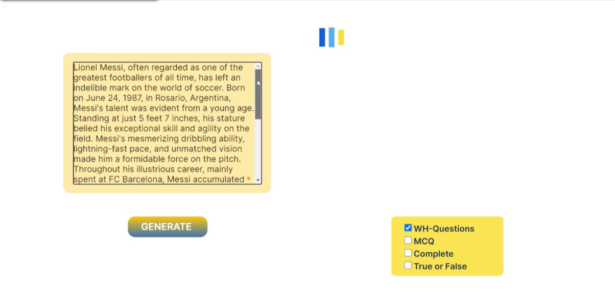

Slide 28
Conclusion & Future Work
Conclusion
Developed a pipelined system for end-to-end question generation.
Two modules: Answer Extraction, and Question Generation.
Four types of questions: WH, true/false, MCQ, and complete.
Results show that the models of our system match and sometimes outperform powerful baseline models and are viable for educational settings.
Future Work
Improve our Boolean QG model by creating a new dataset that utilizes the MCQ pipeline on a reading comprehension dataset.
Making our system multilingual by using multilingual models and datasets.

Slide 29
References
Honnibal, M. (2015). Spacy · industrial-strength natural language processing in python. · Industrial-strength Natural Language Processing in Python. https://spacy.io/.
Campos, Ricardo, et al. "YAKE! Keyword extraction from single documents using multiple local features." Information Sciences 509 (2020): 257-289.
Subramanian, Sandeep, et al. "Neural models for key phrase detection and question generation." arXiv preprint arXiv:1706.04560 (2017)
Raffel, Colin, et al. "Exploring the limits of transfer learning with a unified text-to-text transformer." The Journal of Machine Learning Research 21.1 (2020): 5485-5551.
Kang, Junmo, Haritz Puerto San Roman, and Sung-Hyon Myaeng. "Let me know what to ask: Interrogative-word-aware question generation." arXiv preprint arXiv:1910.13794 (2019).
Liu, B., Zhao, M., Niu, D., Lai, K., He, Y., Wei, H., & Xu, Y. (2019, May). Learning to generate questions by learningwhat not to generate. In The world wide web conference (pp. 1106-1118).
Trask, A., Michalak, P., & Liu, J. (2015). sense2vec-a fast and accurate method for word sense disambiguation in neural word embeddings. arXiv preprint arXiv:1511.06388.
Yuan, W., Yin, H., He, T., Chen, T., Wang, Q., & Cui, L. (2022, April). Unified question generation with continual lifelong learning. In Proceedings of the ACM Web Conference 2022 (pp. 871-881).
Rajpurkar, Pranav, et al. "Squad: 100,000+ questions for machine comprehension of text." arXiv preprint arXiv:1606.05250 (2016).
Trischler, Adam, et al. "Newsqa: A machine comprehension dataset." arXiv preprint arXiv:1611.09830 (2016).
Jia, R., & Liang, P. (2017). Adversarial examples for evaluating reading comprehension systems. arXiv preprint arXiv:1707.07328.
Clark, C., Lee, K., Chang, M. W., Kwiatkowski, T., Collins, M., & Toutanova, K. (2019). BoolQ: Exploring the surprising difficulty of natural yes/no questions. arXiv preprint arXiv:1905.10044.

Slide 30
Thank You

